Slide 1
Sketching Algorithms

Slide 2
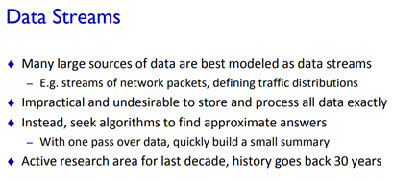

Slide 3
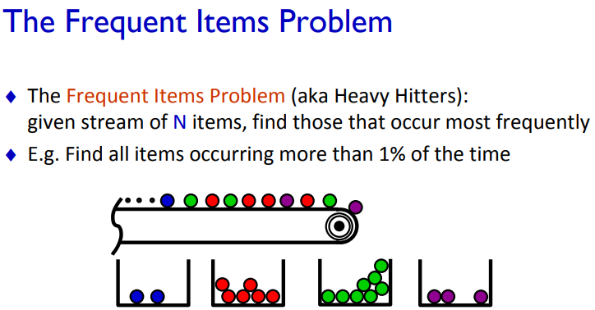

Slide 4
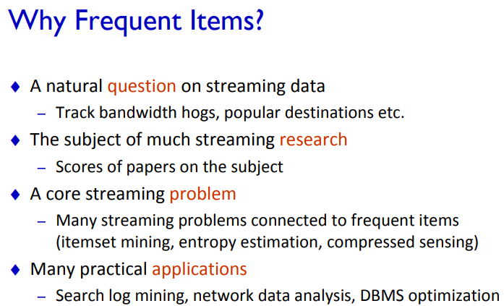

Slide 5
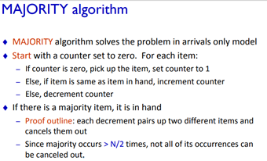

Slide 6


Slide 7
Misra Gries Sketch Algorithm for frequent items

Slide 8
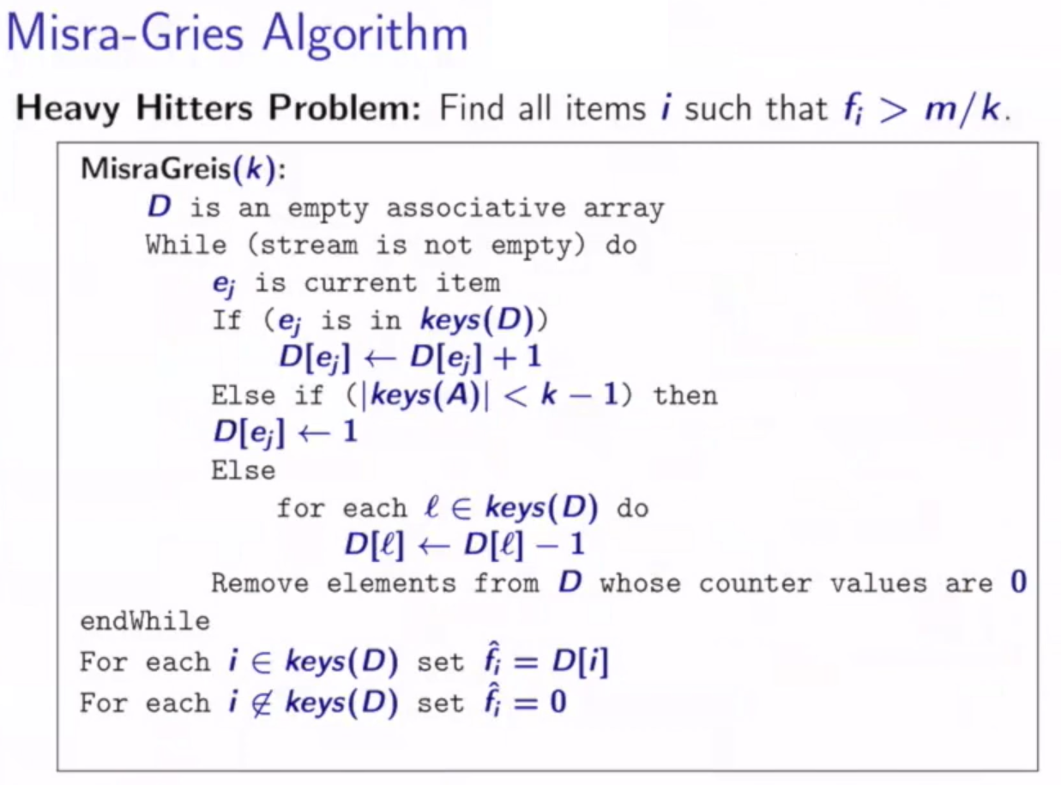

Slide 9
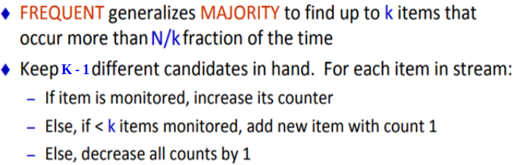
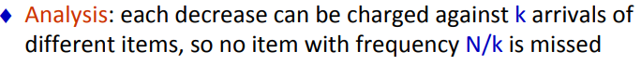
Misra Gries Sketch Algorithm for frequent items

Slide 10
Misra Gries Sketch
G O V G G V V G G P V V G G V Y G P V R G V V O
N = 24 G = 9 , R = 1, Y = 1
K = 3 O = 2 , V = 9, P = 2
N/K = 8

Slide 11
Misra Gries Sketch
R R R B B B R B G Y R B G Y Y R Y Y G G
N = 20 G = 4 , R = 6, Y = 5, B = 5
K = 4
N/K = 5

Slide 12
Count Min Sketch Algorithm

Slide 13
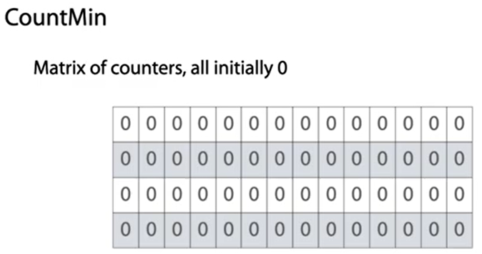
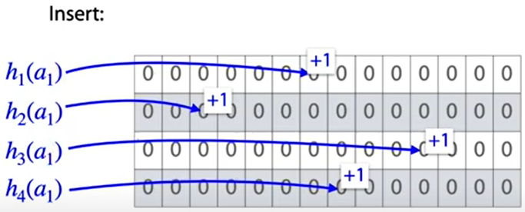
10 20 33 45 5 50 44 34 22 4 6 7 0 1

Slide 14
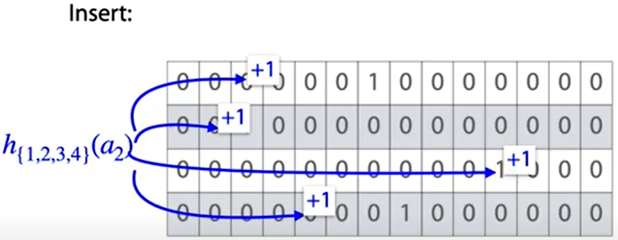
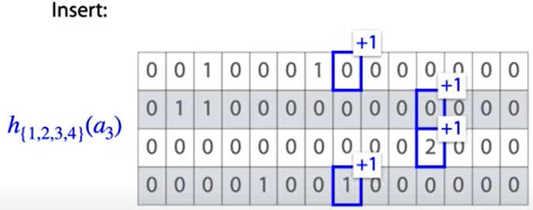
10 20 33 45 5 50 44 33 22 4 6 7 0 1
10 20 33 45 5 50 44 33 22 4 6 7 0 1

Slide 15
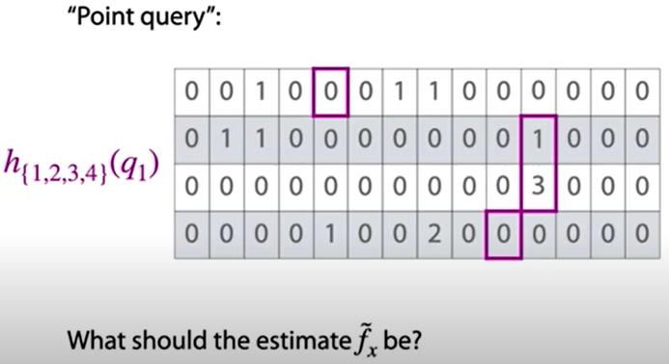
10 20 33 45 5 50 44 33 22 4 6 7 0 1
q1 is not present because of 0s in first and fourth row.

Slide 16
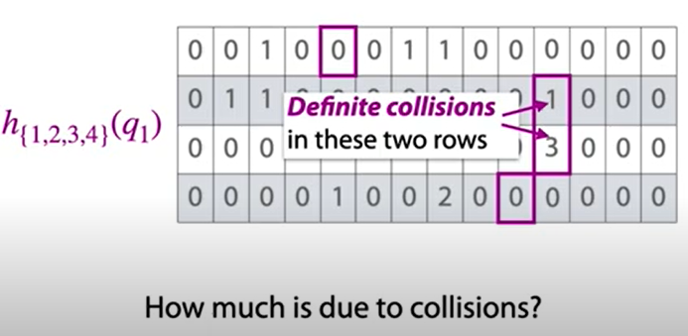

Slide 17
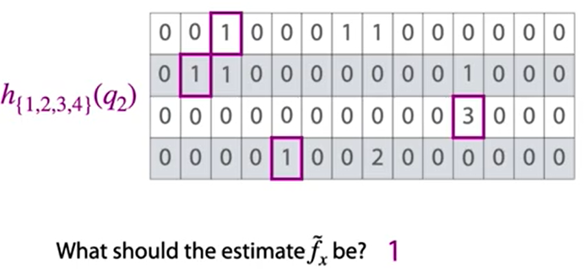

Slide 18
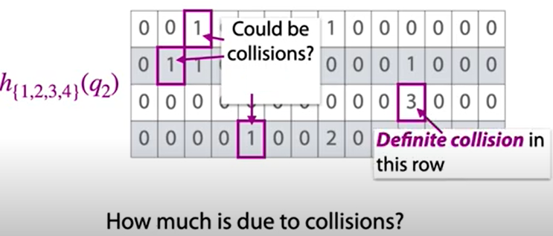

Slide 19
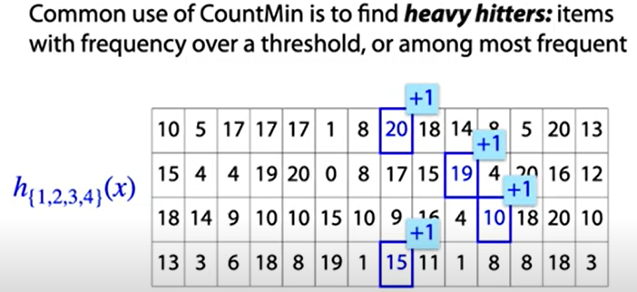

Slide 20
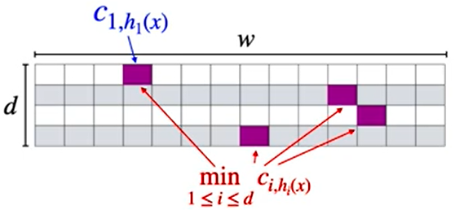
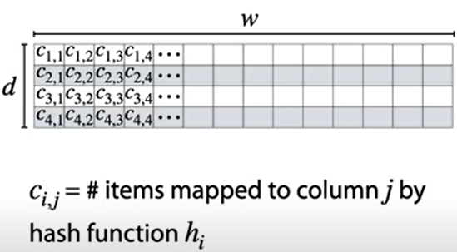

Slide 21
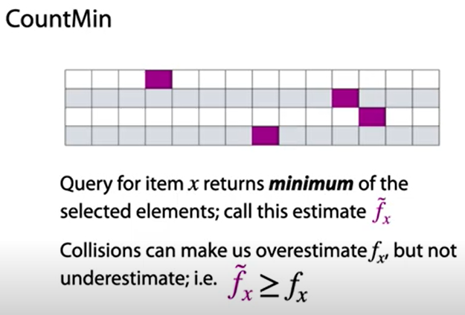

Slide 22
Count Min Sketch Algorithm
Refer notes for solved sum

Slide 23
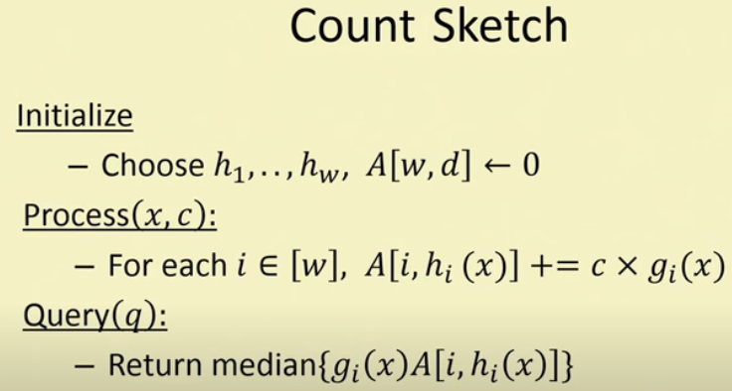

Slide 24
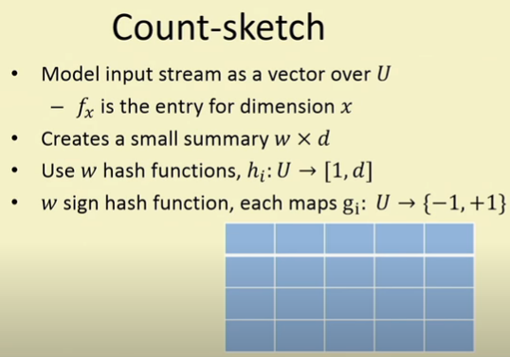

Slide 25
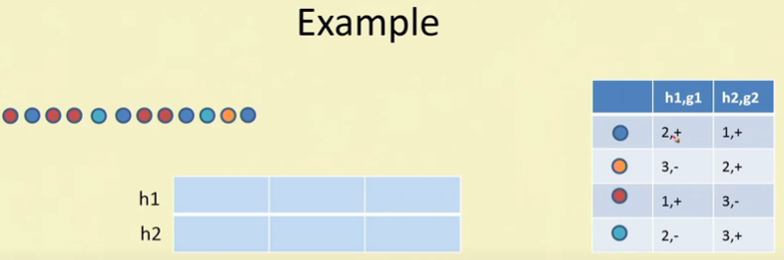
Count Sketch Algorithm

Slide 26
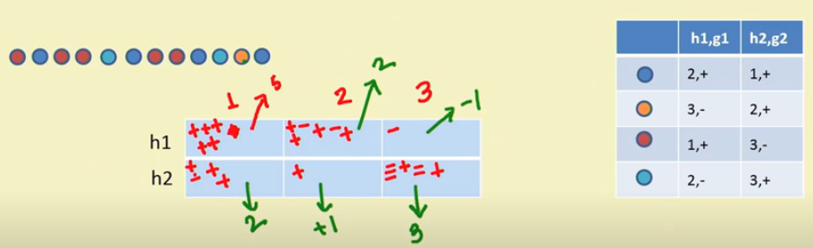

Slide 27
Refer notes for solved sum

Slide 28

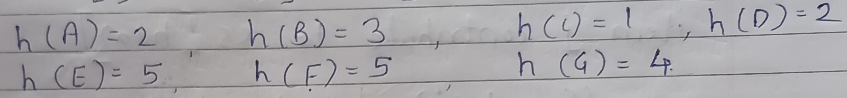
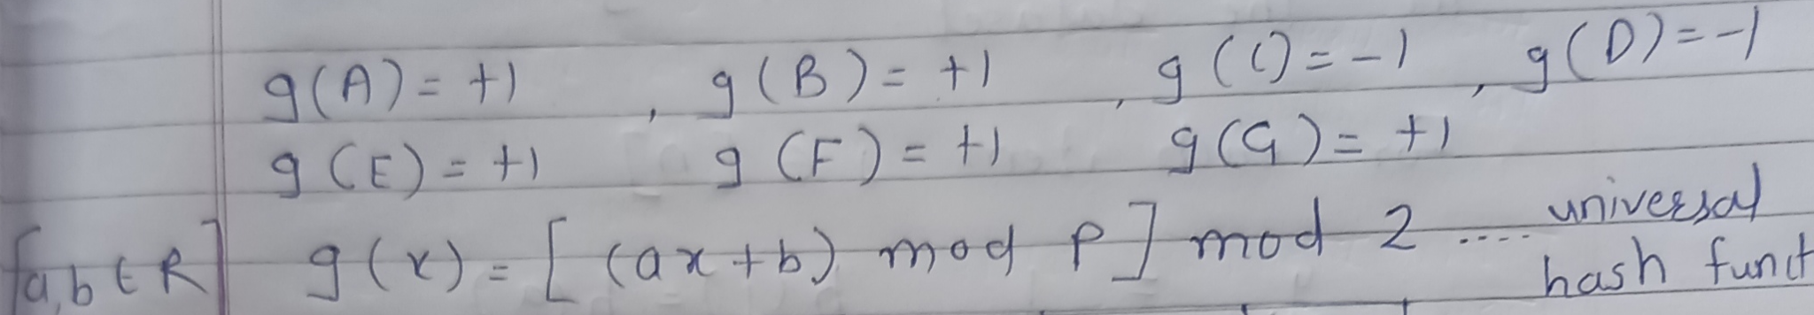
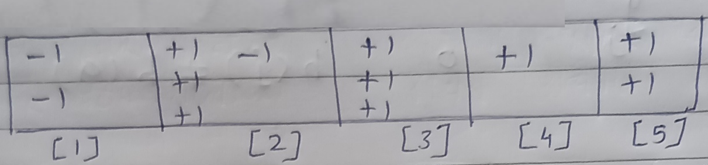

Slide 29
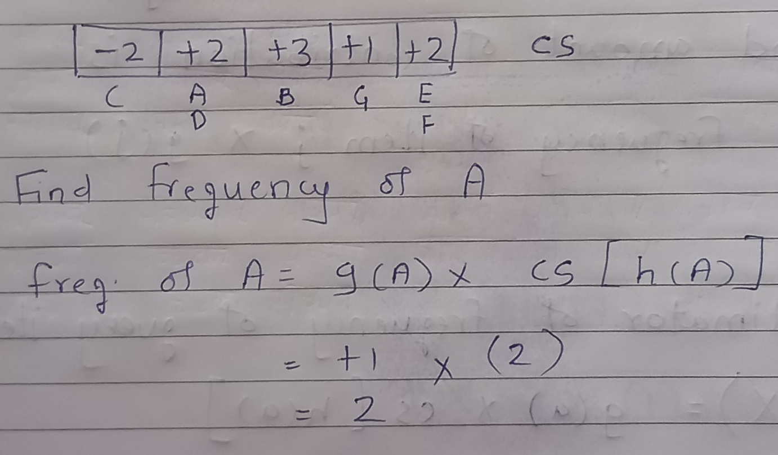

Slide 30
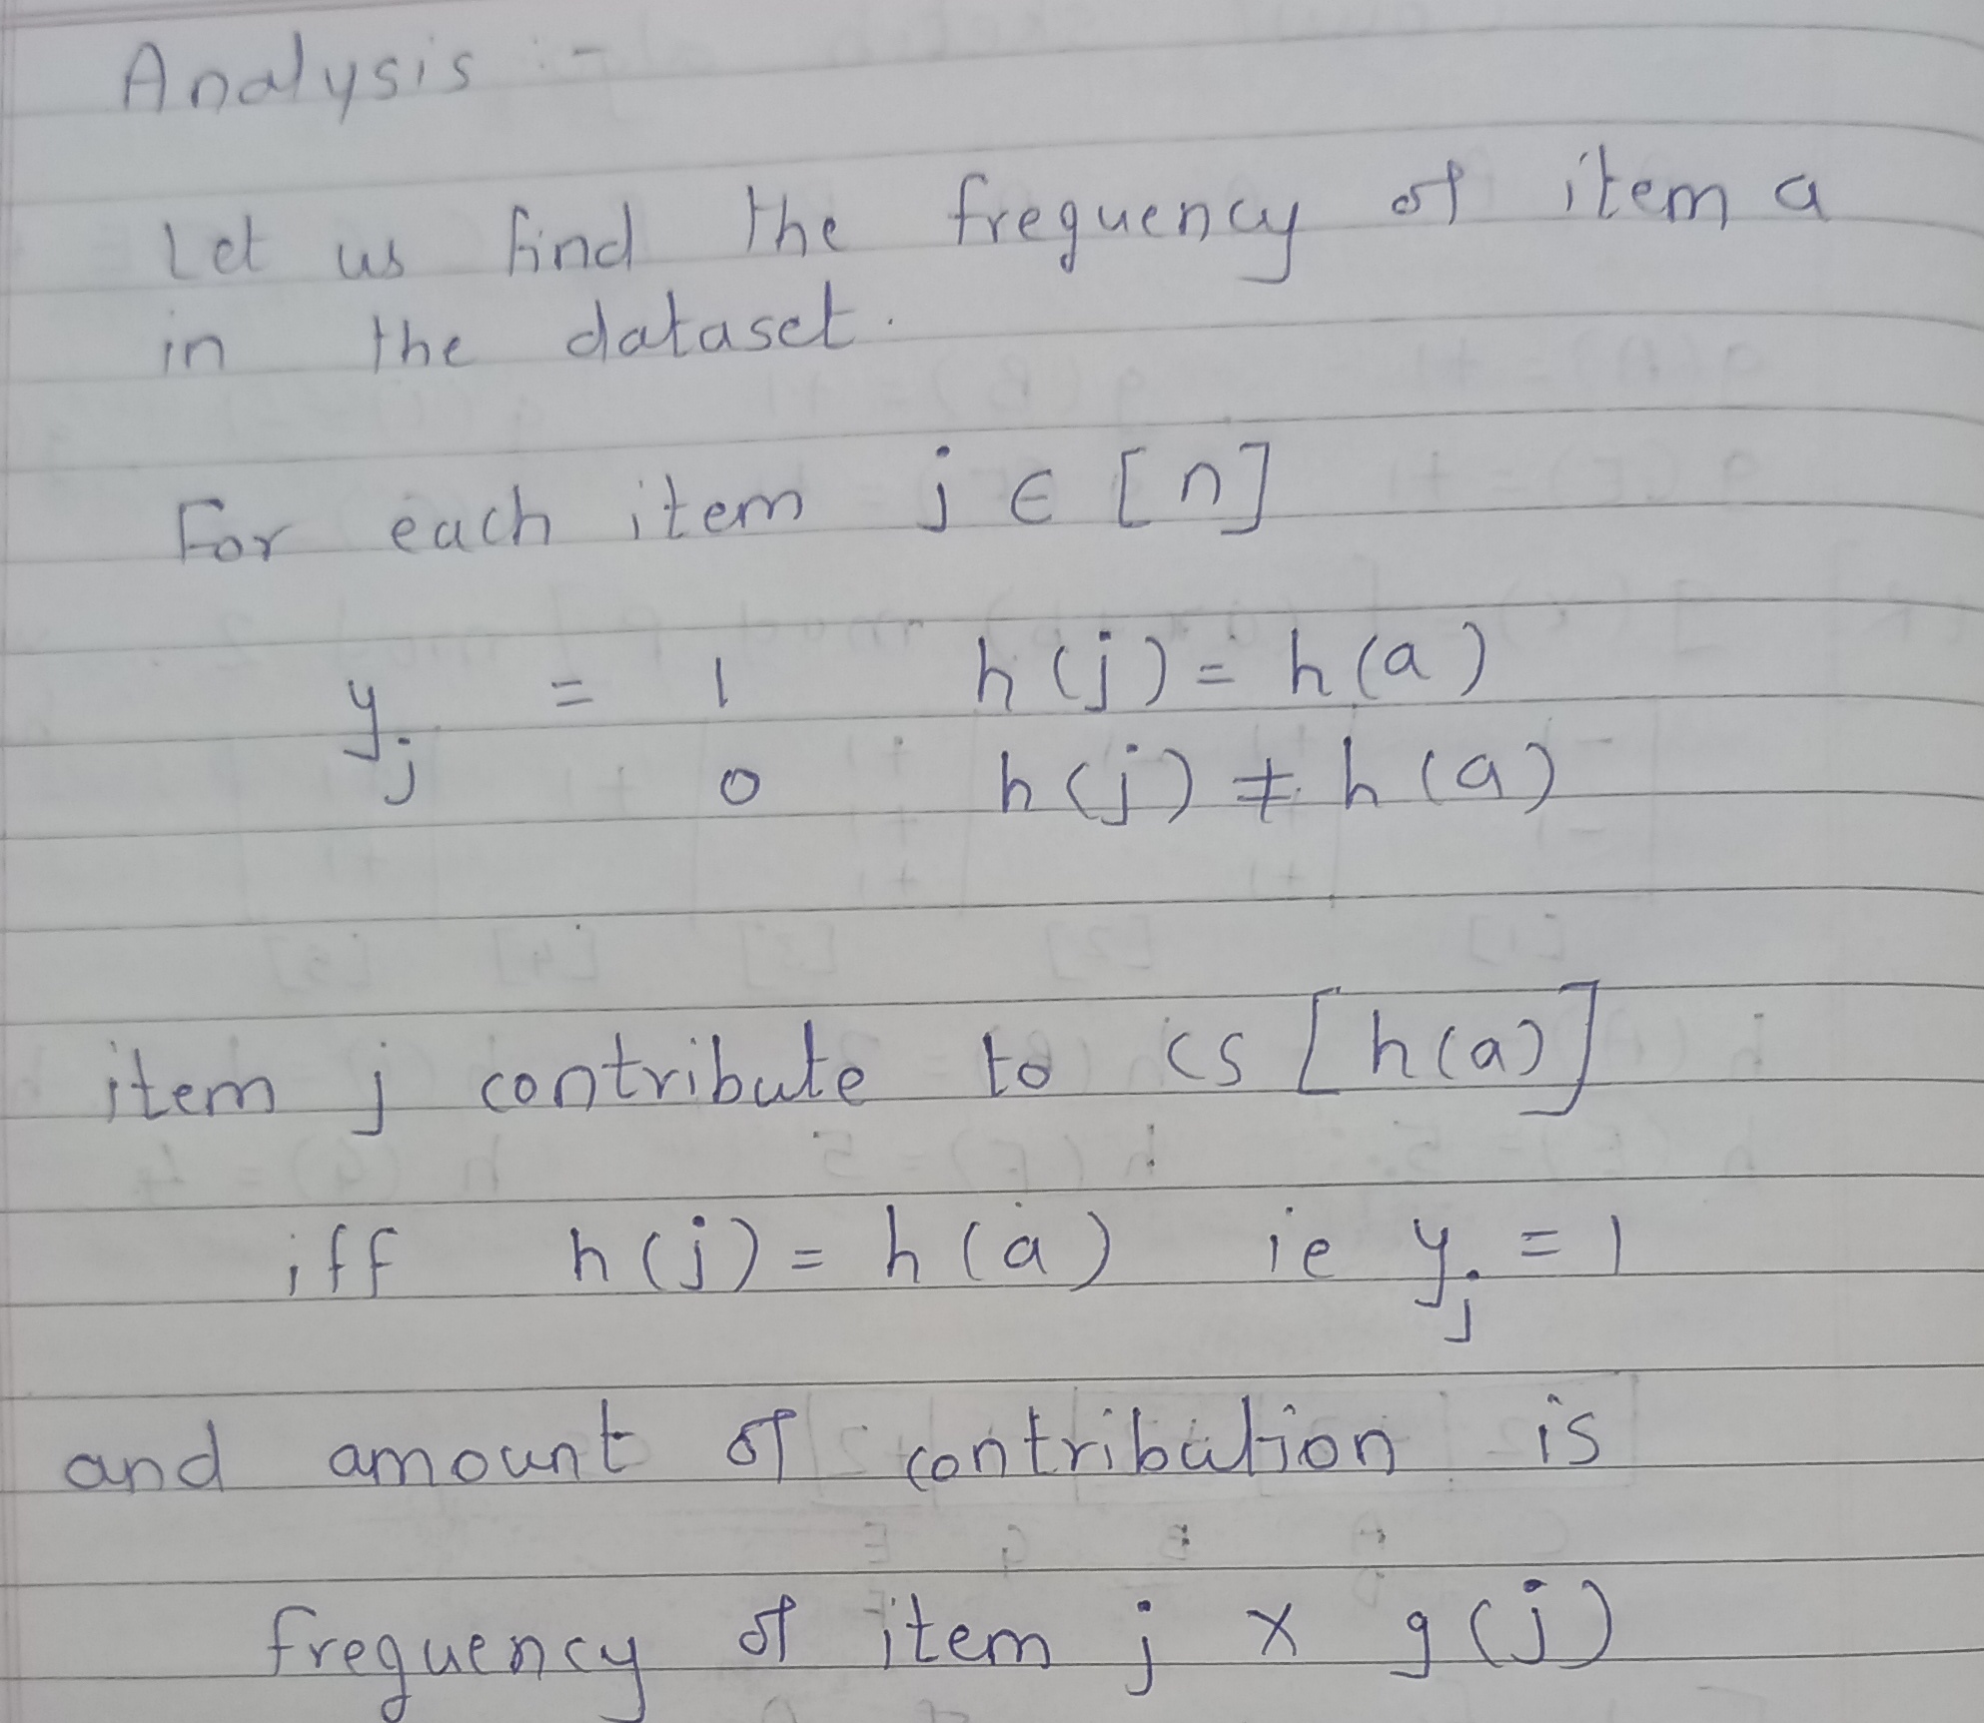

Slide 31
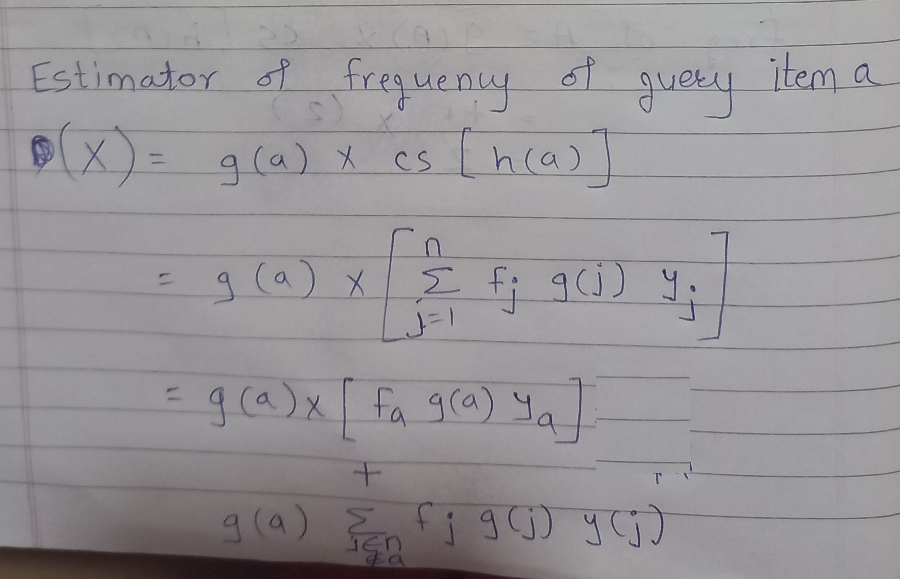

Slide 32
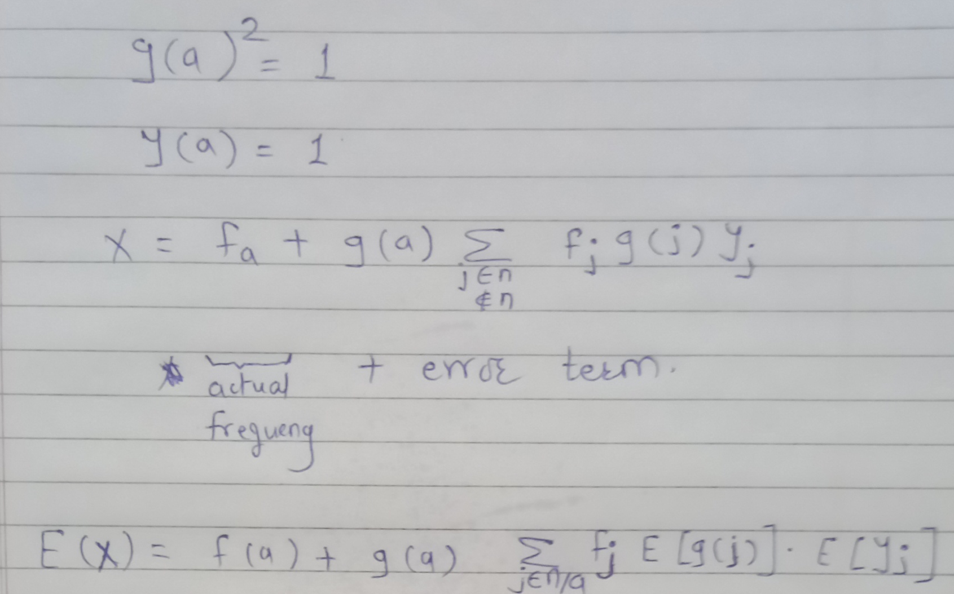

Slide 33
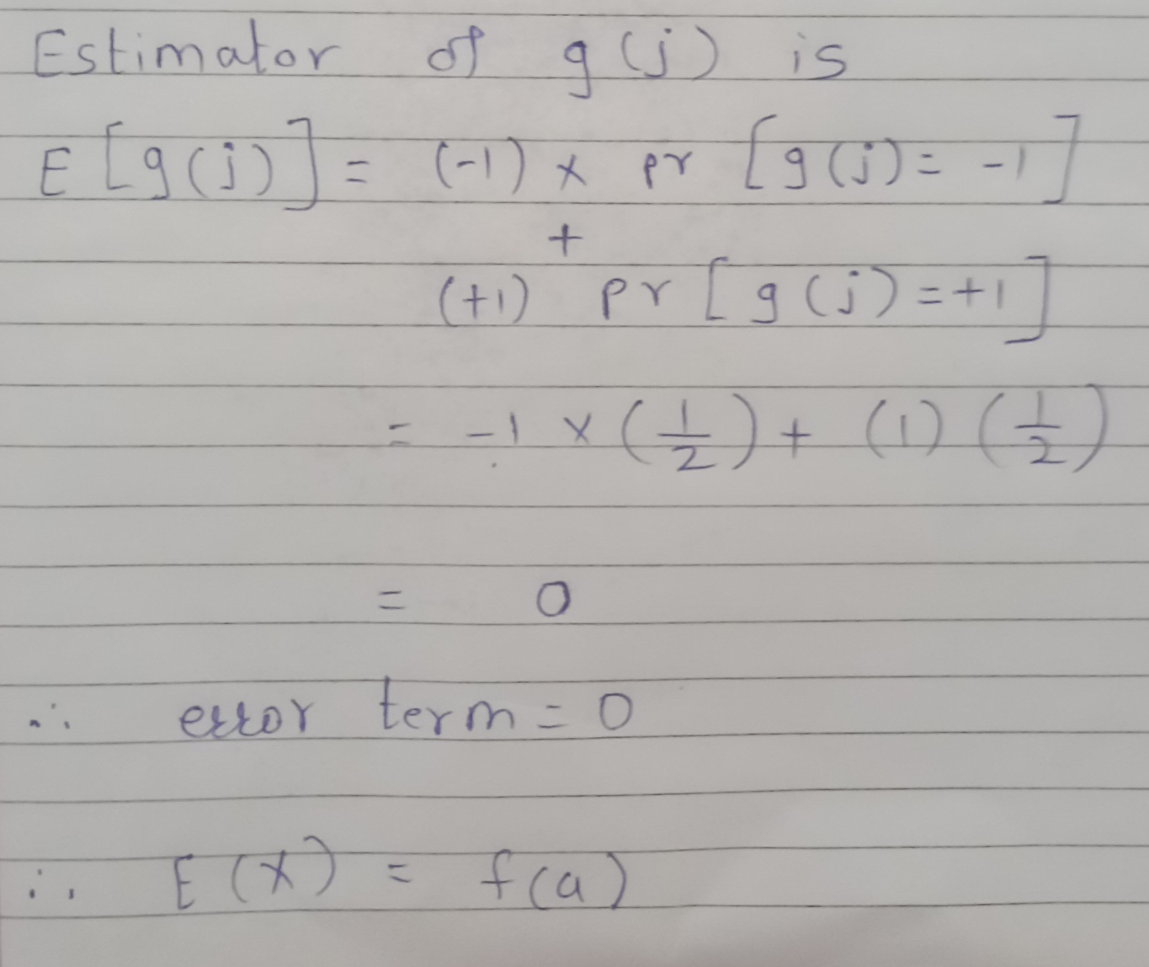

Slide 34
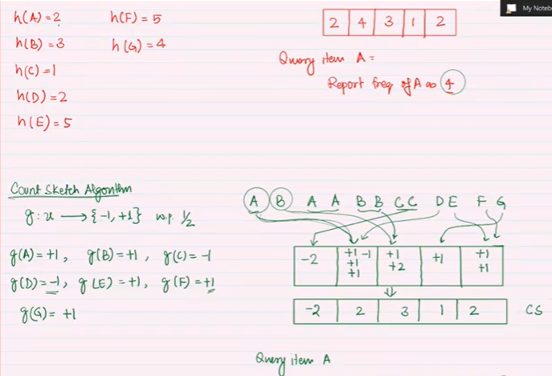

Slide 35
